Slide 1
How to Teach Computers to Process Natural Language S2: AI on Sentiment Analysis and Making a Chatbot
Dr. Du Pengfei
SVS/DMD
28 Mar 2024

Slide 2
Agenda
Basic background knowledge briefing of NLP
Hands on through https://machinelearningforkids.co.uk/#!/about :
First round:
Speech Recognition: Project of Making a Smart Bulb on Scratch 3
2nd round:
Sentiments Analysis: Project of Making Me Happy on Scratch 3
Make chatbot and encourage students to implement more creative projects on top of those achievements.

Slide 3
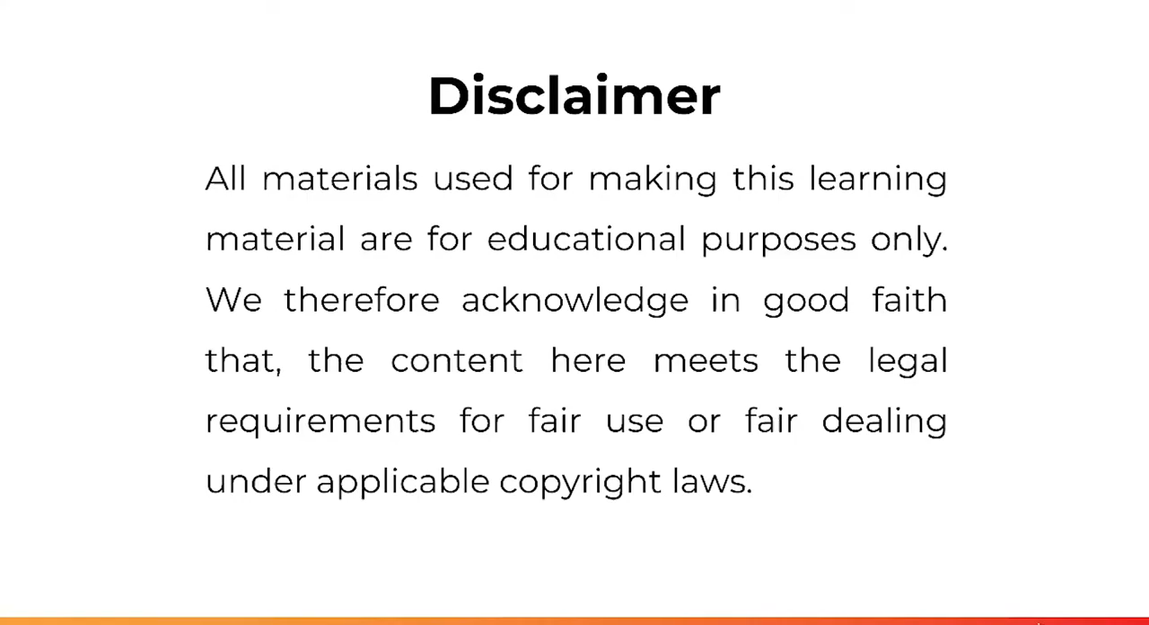
Sentiment Analysis

Slide 4
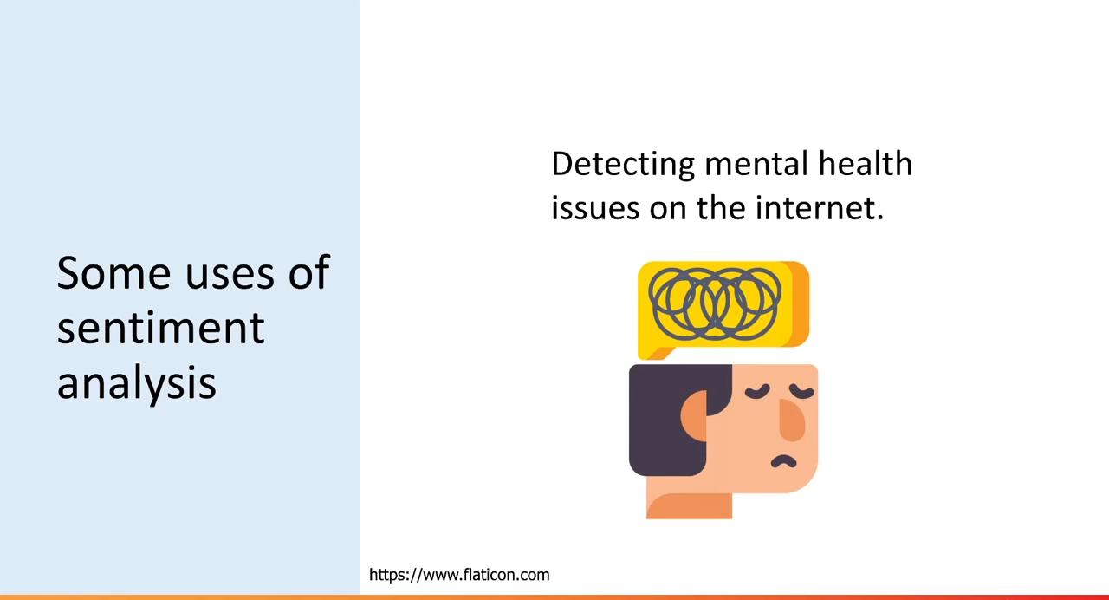
Hands on

Slide 5
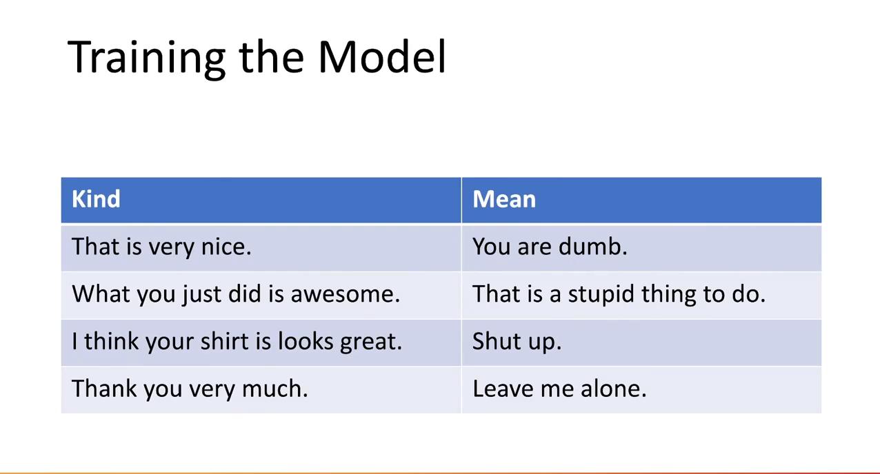
Summary

Slide 6
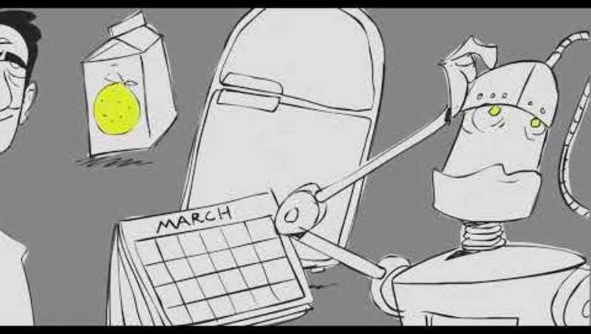
Chatbot and Turing Test

Slide 7
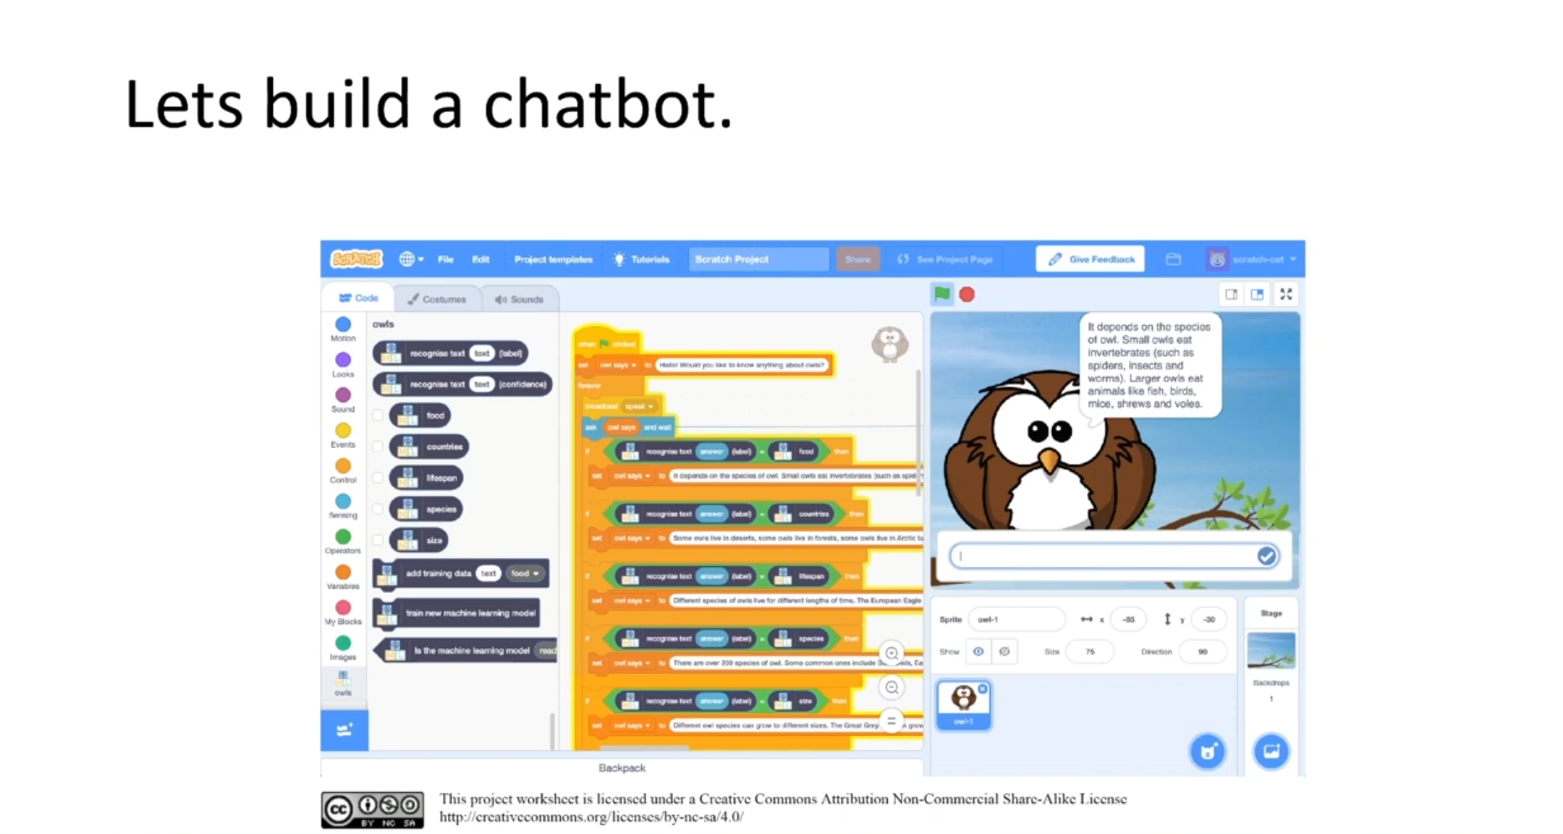
Hands on

Slide 8
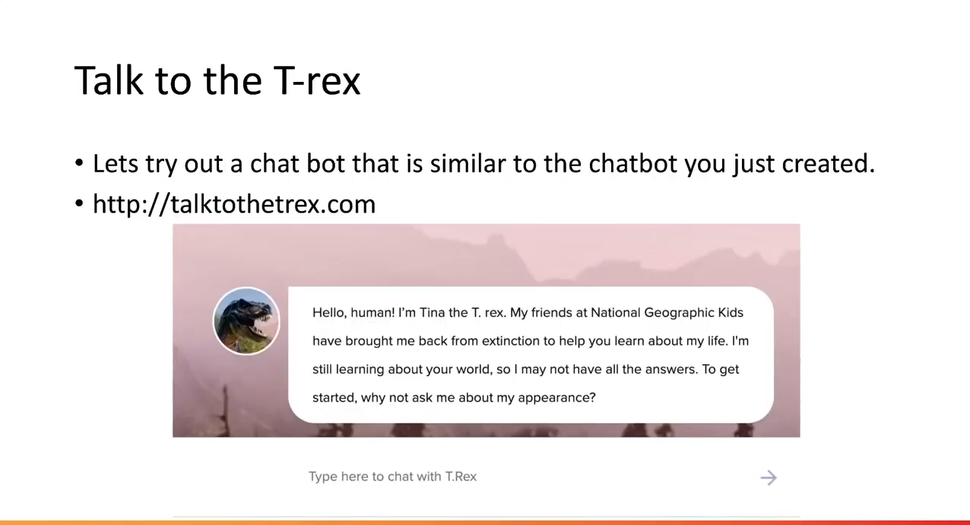
Summary

Slide 9
Contact: Du Pengfei
du_pengfei@SIMTech.a-star.edu.sg

